Slide 1
Unity / Rocket Golf
By Caleb Carlson, Brandon Neff, and Nathan Spaulding

Slide 2
Downloading Unity
See Dr. Ward’s slides for downloading Unity
MAKE SURE TO DOWNLOAD ANDROID BUILD SUPPORT!!!

Slide 3
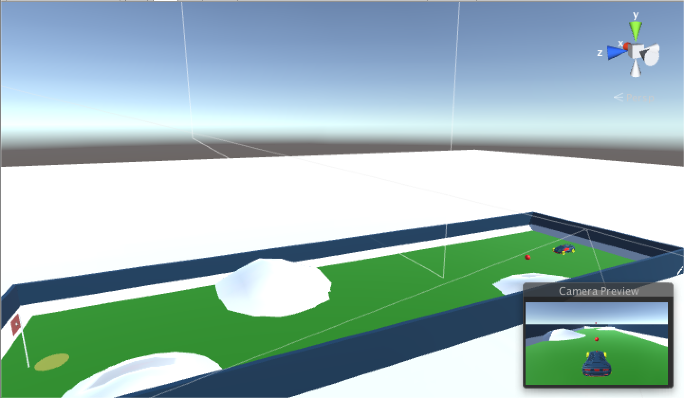
Rocket Golf!!!

Slide 4
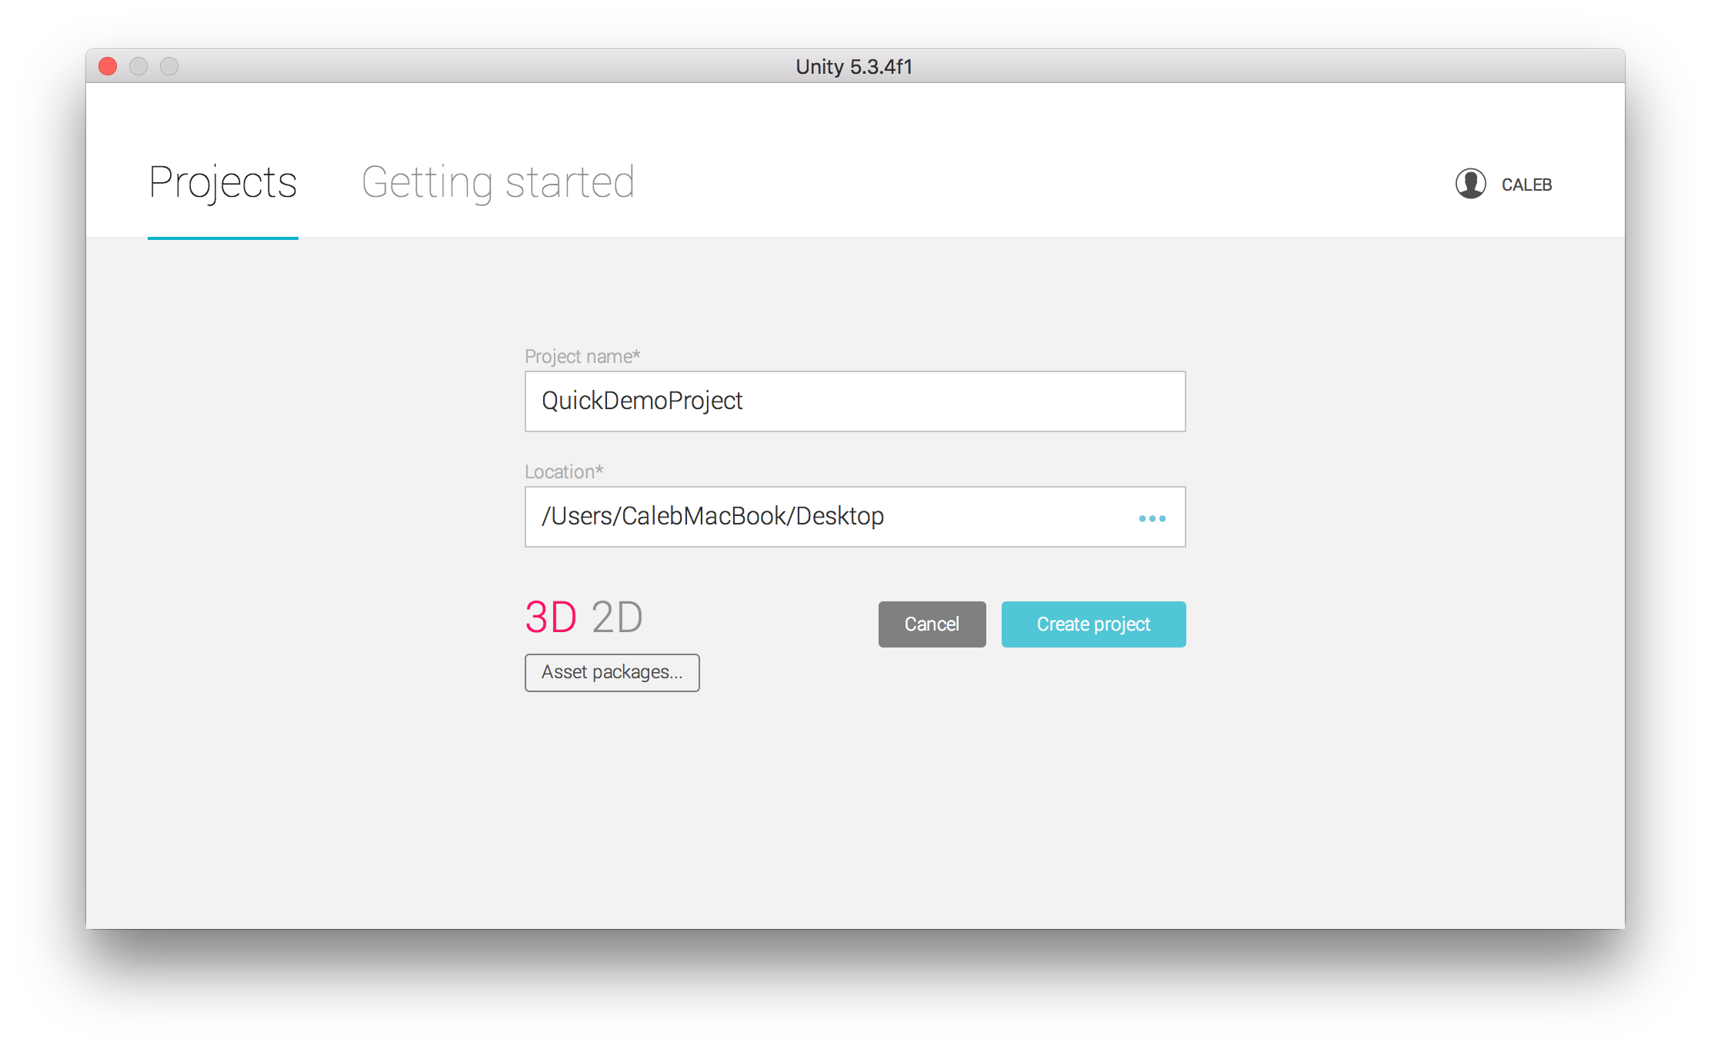
Creating A Project

Slide 5
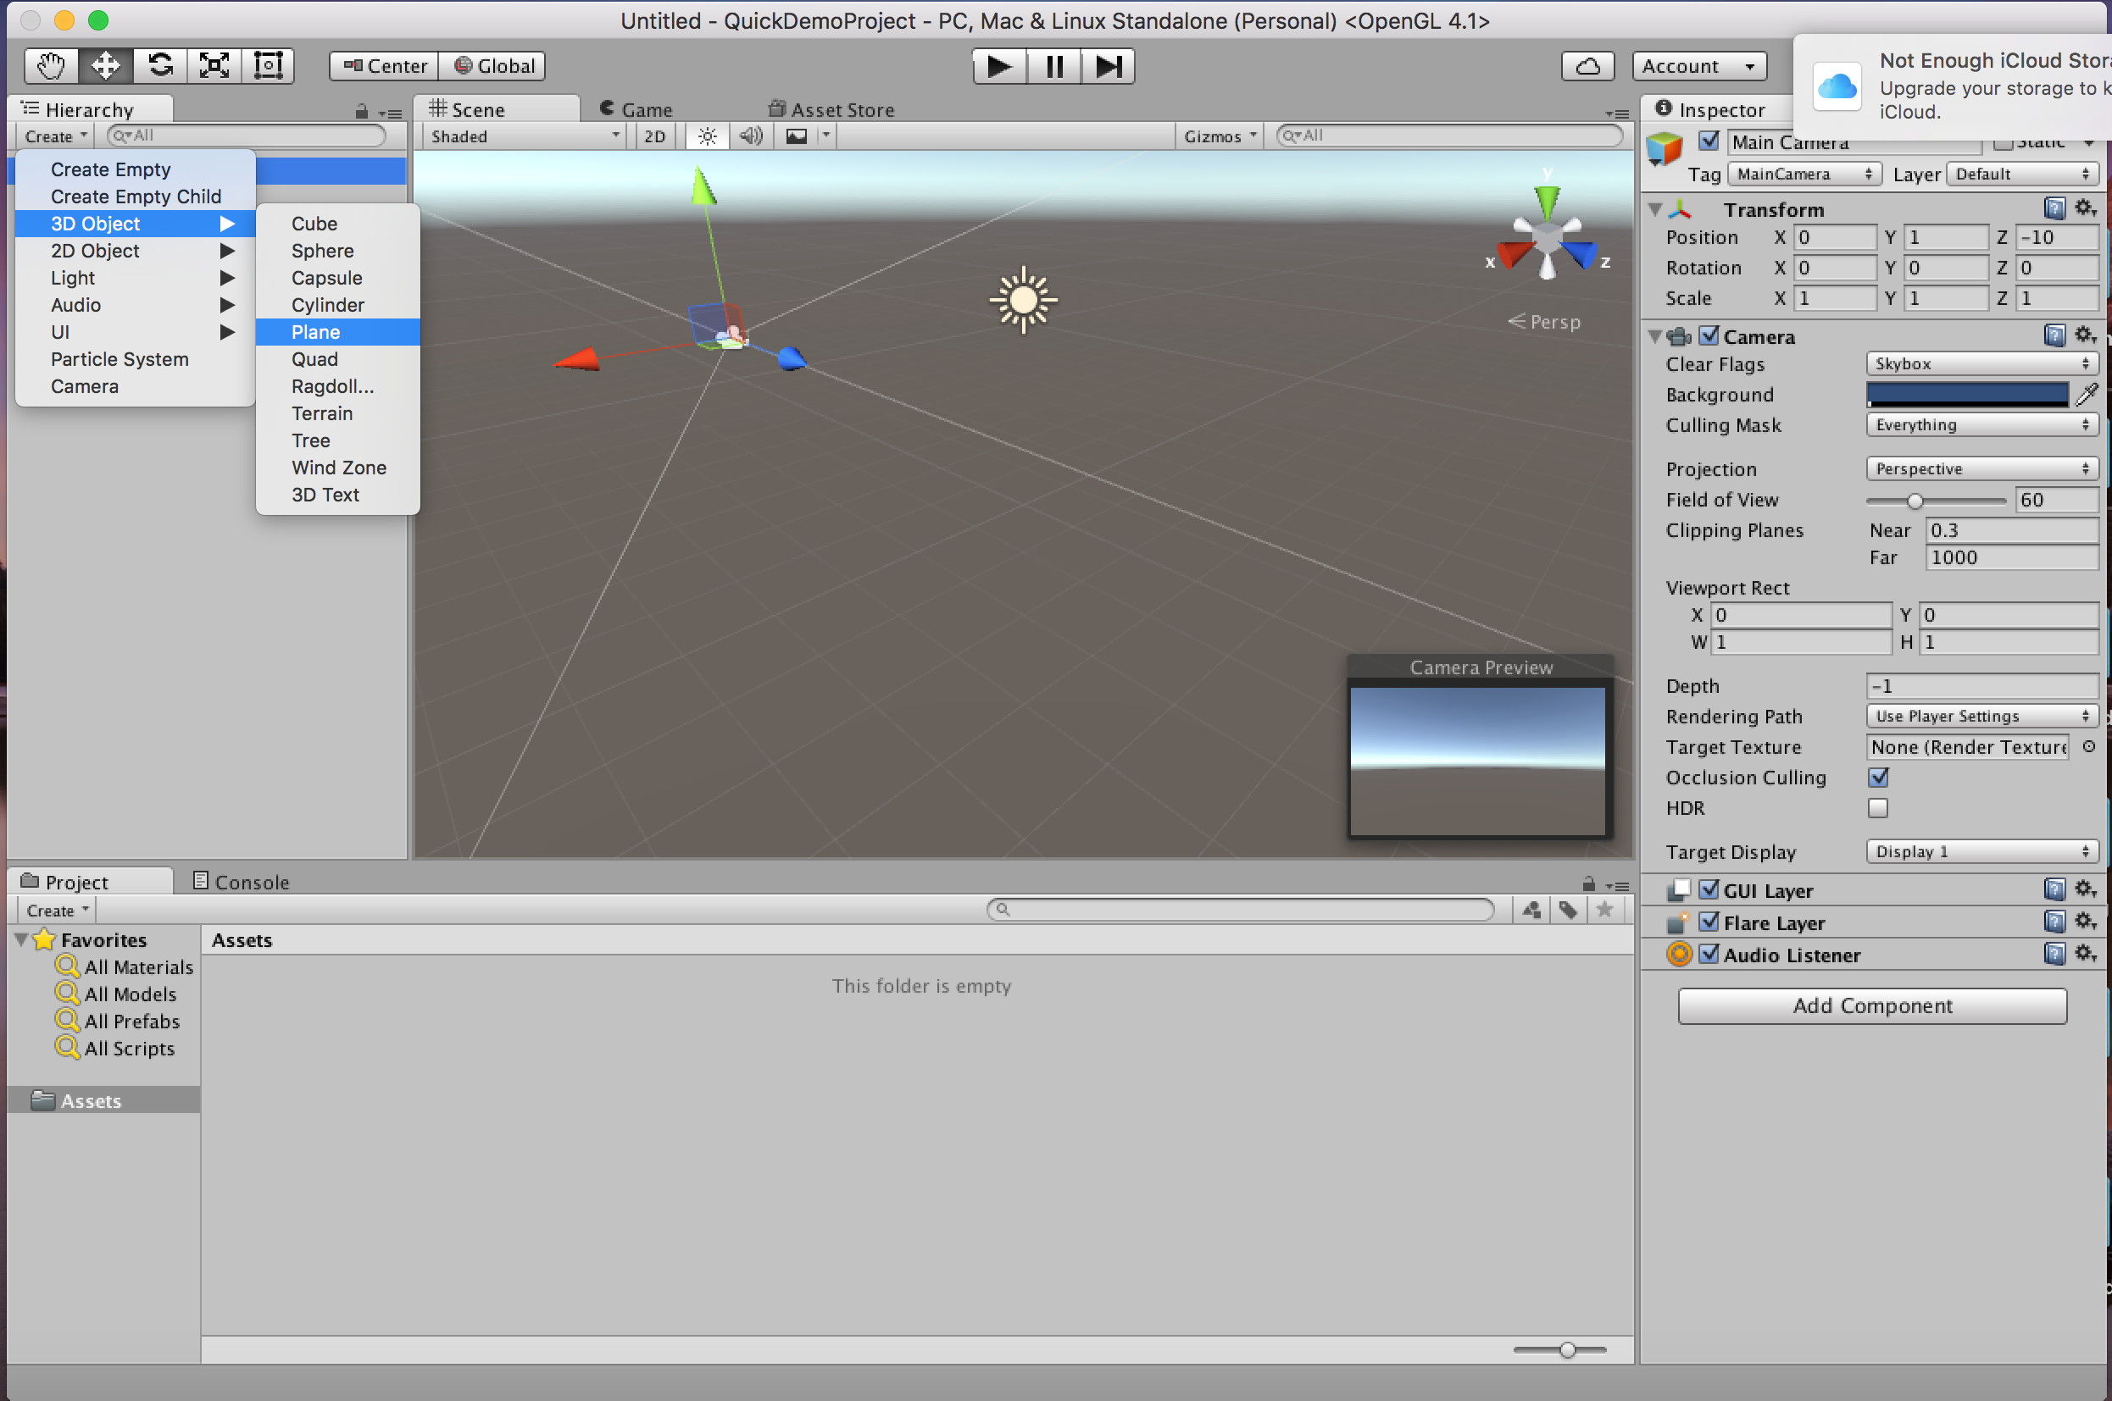
Creating Shapes

Slide 6
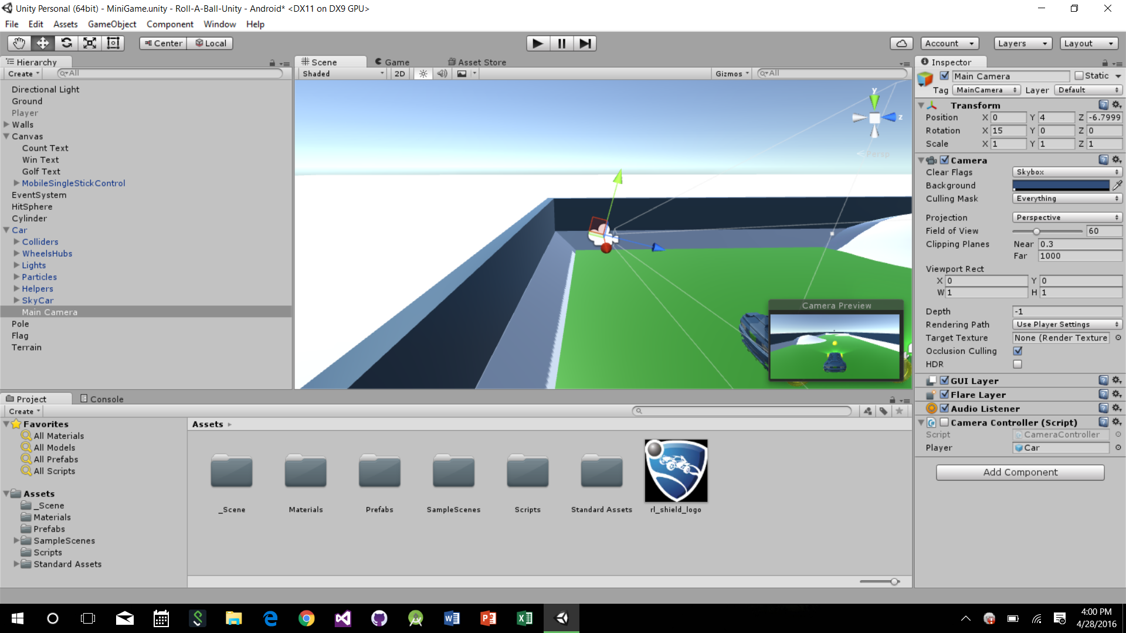
The Camera
Display the content of the entire project to the user.
When a new scene is created, a GameObject is created and the camera is then paired with that object.

Slide 7
Camera Script to track the ball
public GameObject player; private Vector3 offset; // Use this for initialization void Start () { offset = transform.position - player.transform.position; } // Update is called once per frame void LateUpdate () { transform.position = player.transform.position + offset; }

Slide 8
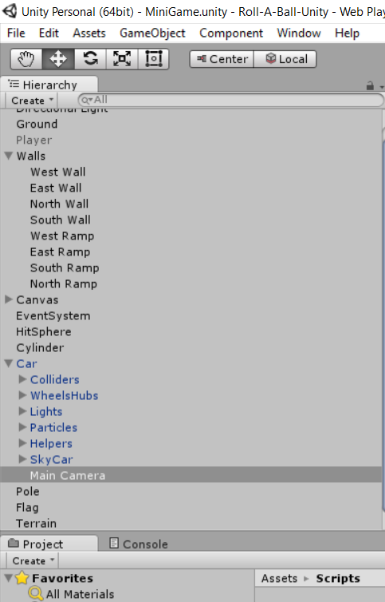
Fixing Camera Location

Slide 9
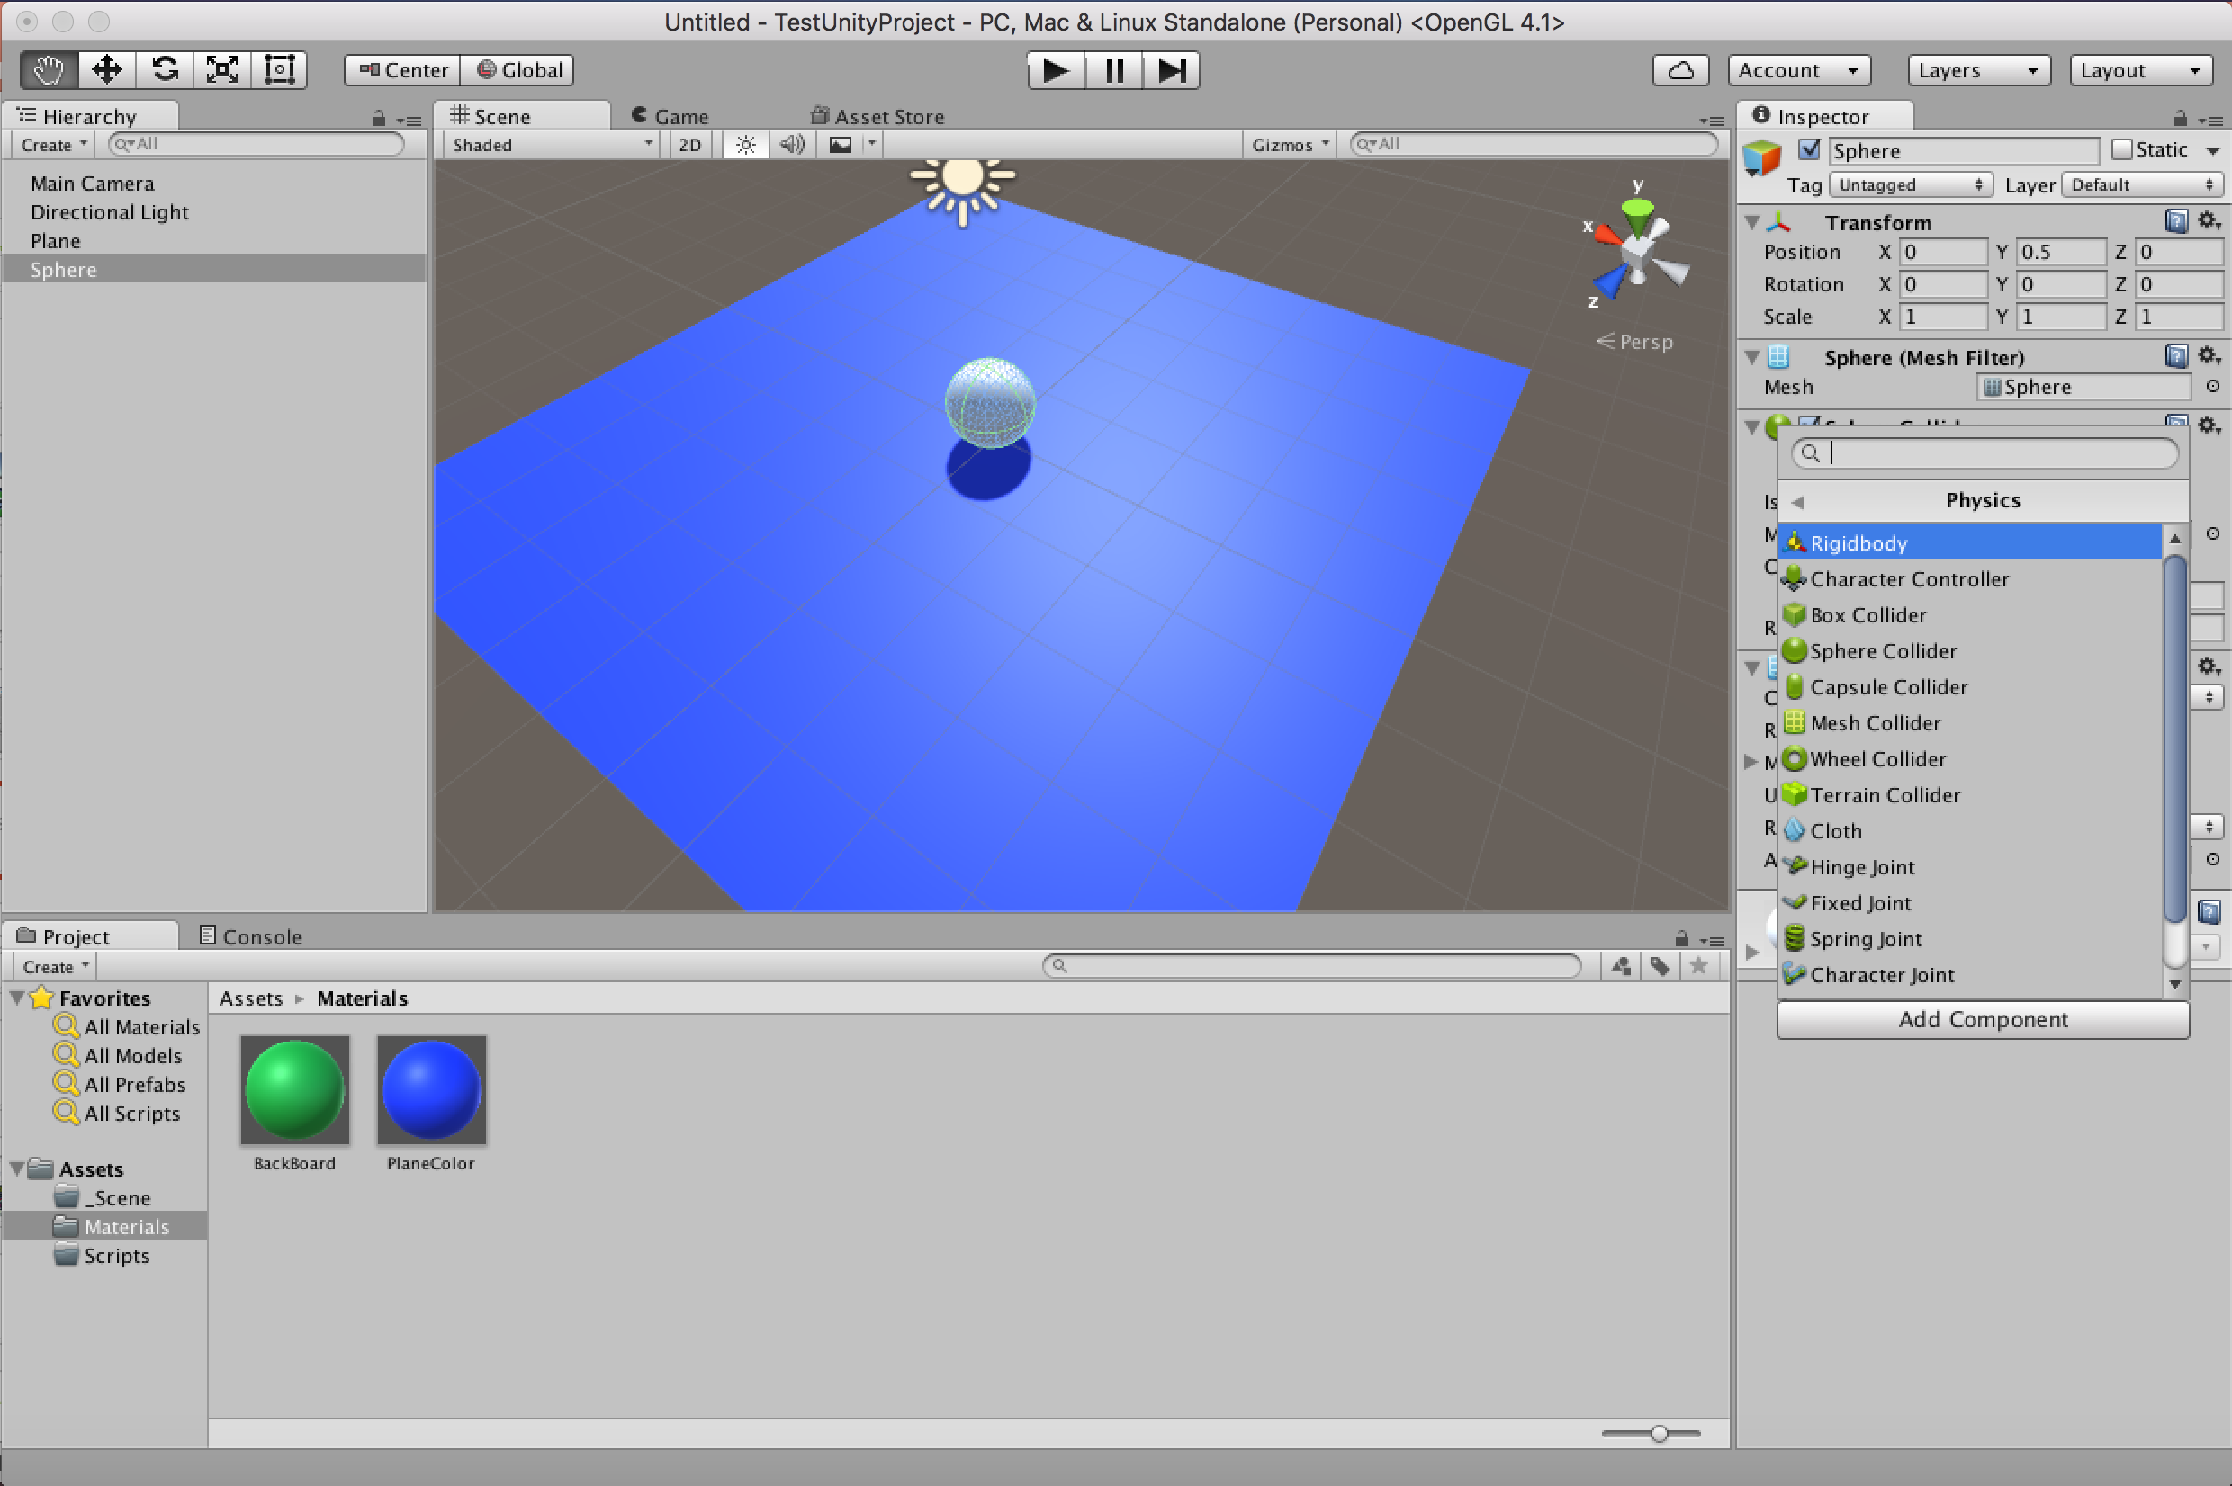
Physics
To get an object to animate you need to add a Rigidbody to you object. This is the basic 3D Physics component to get your object to act to collisions and gravity.

Slide 10
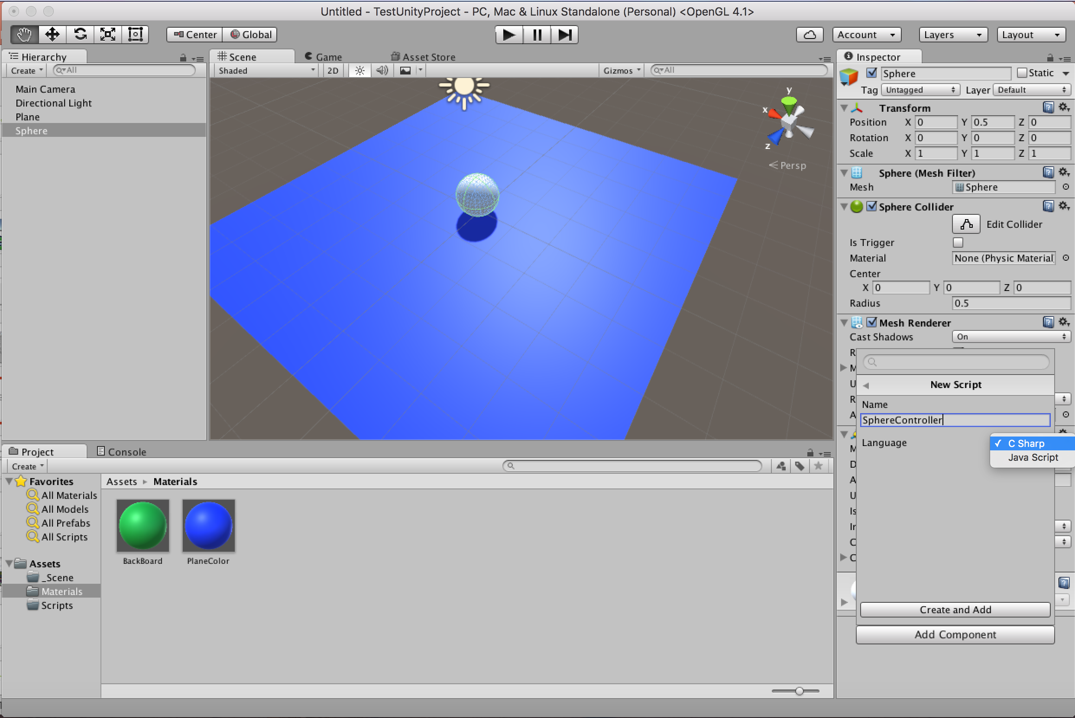
Scripts
Scripts allow you to modify how objects interact with each other beyond the basic collision.

Slide 11
Two Types Of Contact: Collision vs Trigger
Triggers are used when you want to objects to overlap and “collect” each other
Collisions are meant for when objects are going to collide and have physics forces act on each shape

Slide 12
To the project!

Slide 13
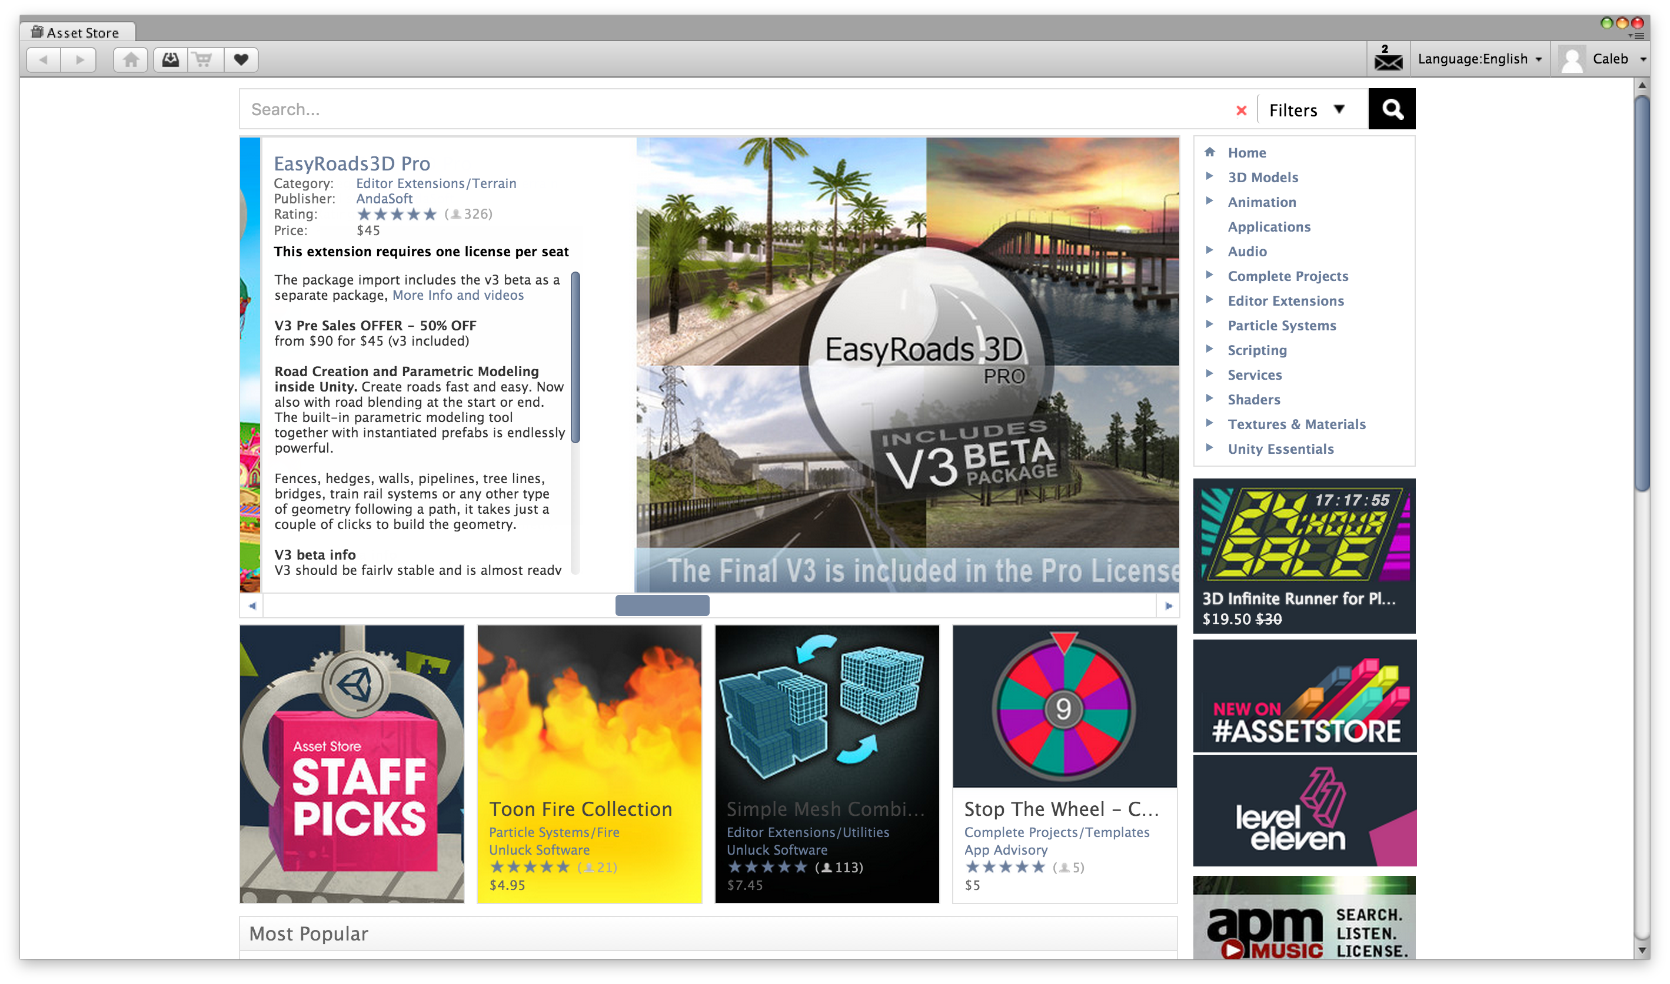
How did we make that awesome car??? We didn’t… Assets Store

Slide 14
Adding textures, trees, and more has never been easier!

Slide 15
Exporting the project!

Slide 16
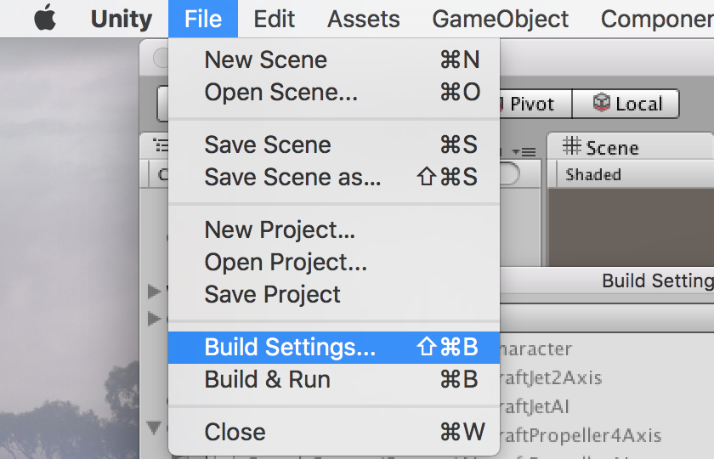
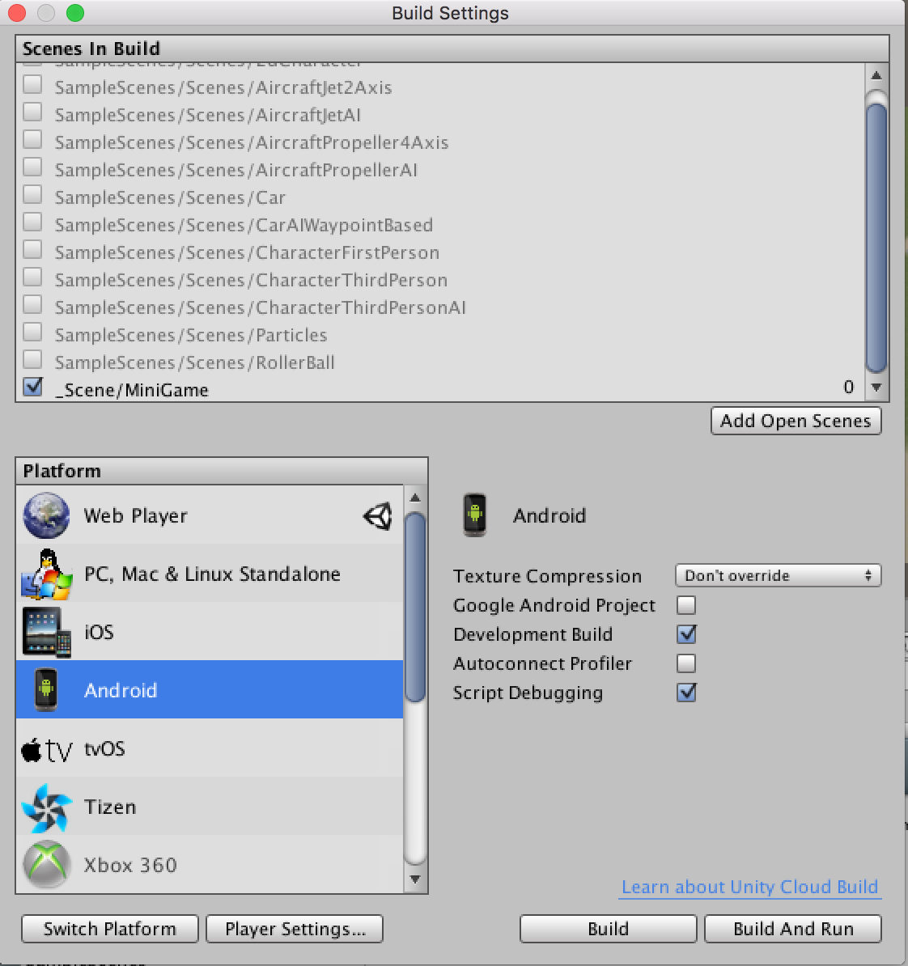
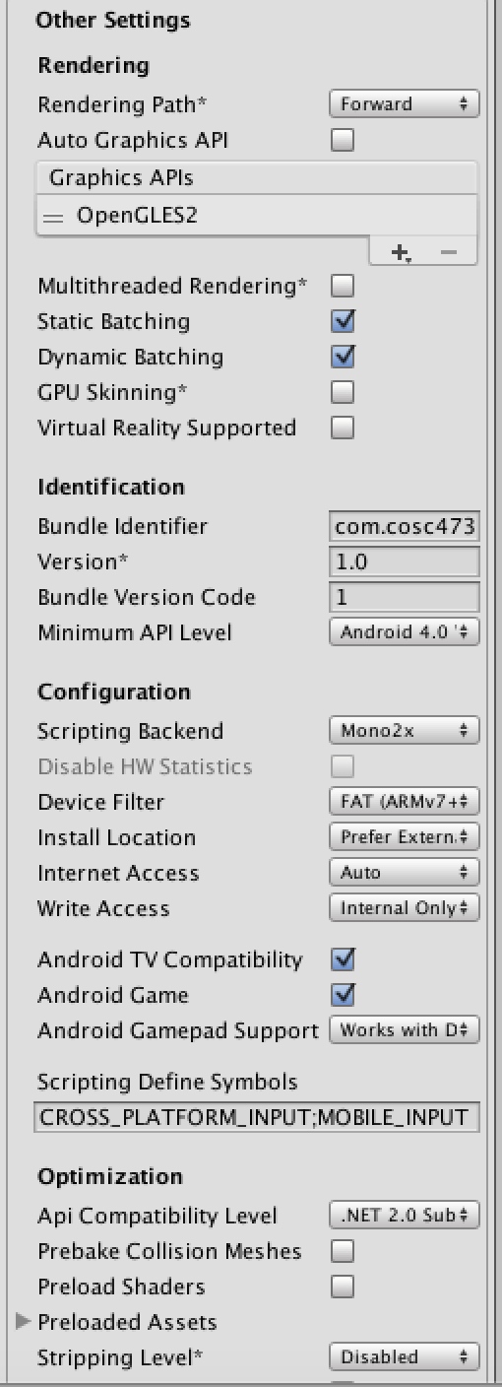
Exporting the project!

Slide 17
Building in Android
Back to the project!

Slide 18
It even works on IOS devices
Back to the project!

Slide 19
References
http://unity3d.com/learn/tutorials/projects/roll-ball-tutorial (Great tutorial for game basics)
http://docs.unity3d.com/Manual/index.html (Unity Manual)
https://www.assetstore.unity3d.com/en/ (Asset Store)

Slide 20
Play the game that inspired it all….

Slide 21
Q & A

